Slide 1
SUPPLY CHAIN MANAGEMENT
By:
Rekha. J
Learn Bay

Slide 2
Business Problem:
FMCG company has entered into the instant noodles business two years back. Their higher management has notices that there is a miss match in the demand and supply. Where the demand is high, supply is pretty low and where the demand is low, supply is pretty high. In both the ways it is an inventory cost loss to the company; hence, the higher management wants to optimize the supply quantity in each and every warehouse in entire country.

Slide 3
GOAL & OBJECTIVE
The objective of this exercise is to build a model, using historical data that will determine an optimum weight of the product to be shipped each time to the warehouse.
To determine the Ideal Quantity of Product Weight Shipped to the various Ware Houses of FMCG Instant Noodles Company in order to reduce wastage of the Product, Bridge the Demand – Supply Gap and avoid over-stacking of Products in the Ware Houses.
.

Slide 4
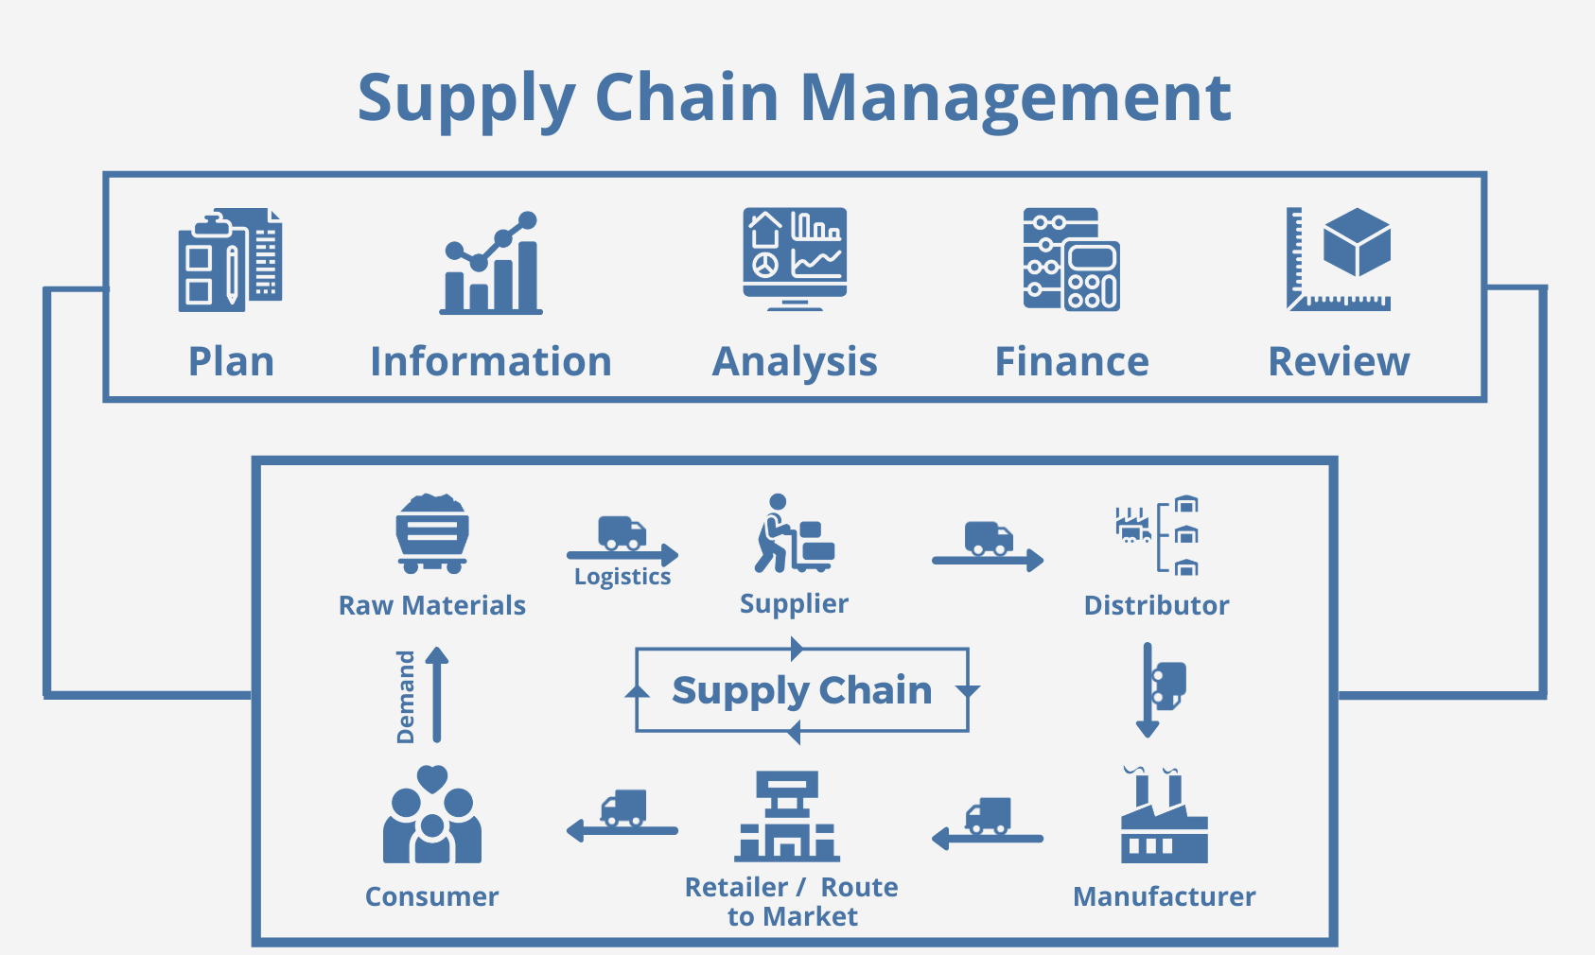

Slide 5
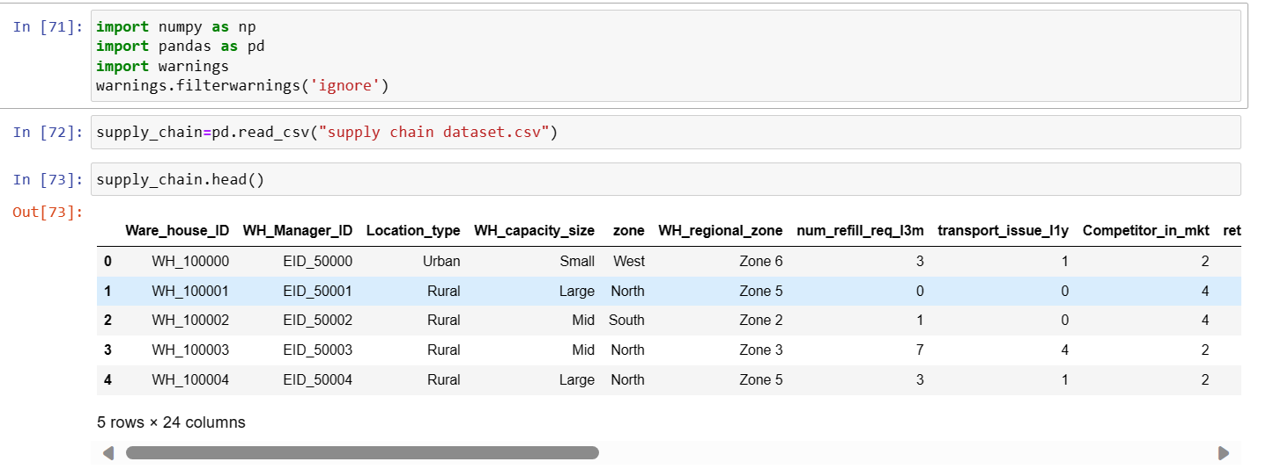
Load and Read the Dataset

Slide 6
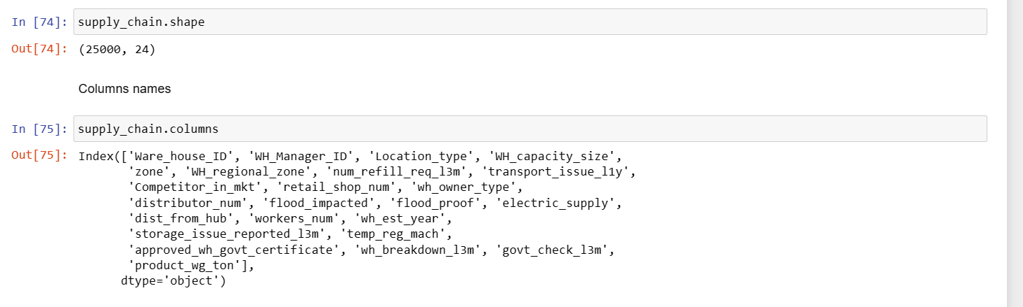
Visual inspection of data: Check the number of rows and columns

Slide 7
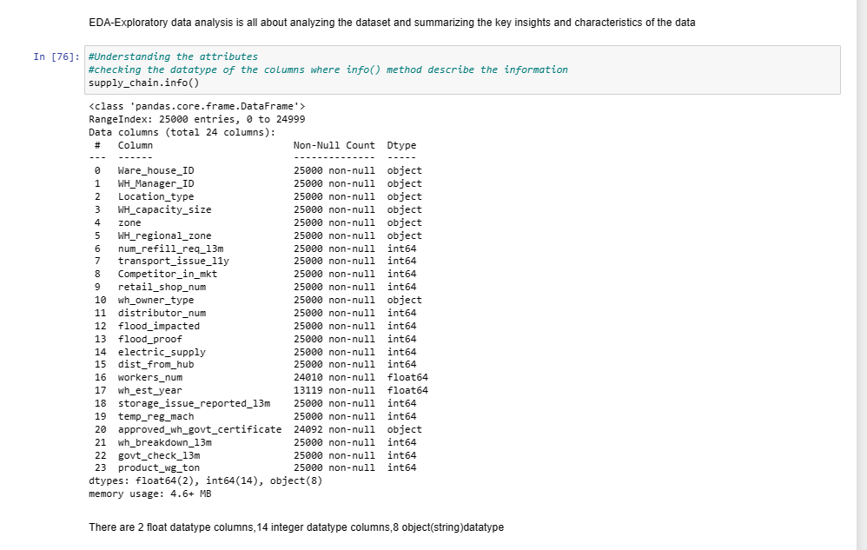
Exploratory data analysis

Slide 8
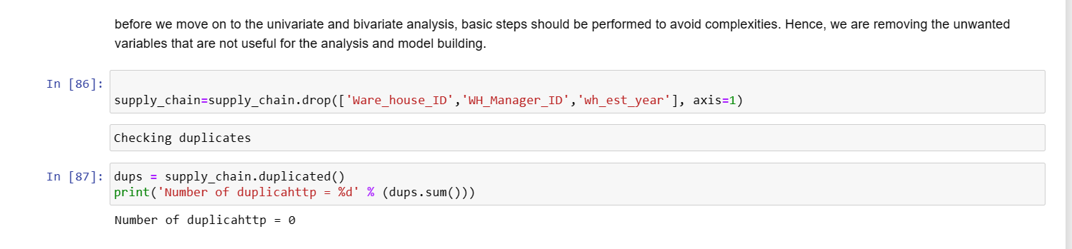
REMOVAL OF UNWANTED VARIABLES

Slide 9
CATEGORICAL FEATURES

Slide 10
CATEGORICAL FEATURES

Slide 11
CATEGORICAL FEATURES

Slide 12
CATEGORICAL FEATURES

Slide 13
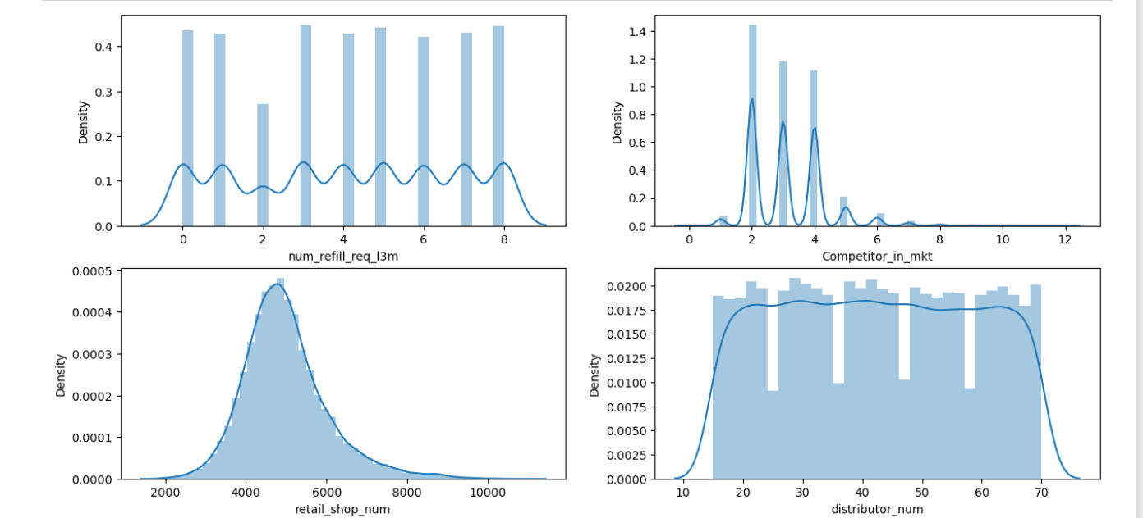
UNIVARIATE ANALYSIS

Slide 14
FINDINGS:
num_refill_req_l3m:
Right-skewed distribution with a peak around 8 refill requests. Most warehouses have a moderate level of refill requests.
Competitor_in_mkt:
Majority of warehouses face competition from 2 to 3 competitors. Fewer warehouses experience higher levels of competition.
Retail_shop_num:
Some what right-skewed distribution. Most warehouses have a moderate number of retail shops, but some have a higher count.
distributor_num:
Distributor involved from the distribution from warehouse to the retail shop is spread out.

Slide 15
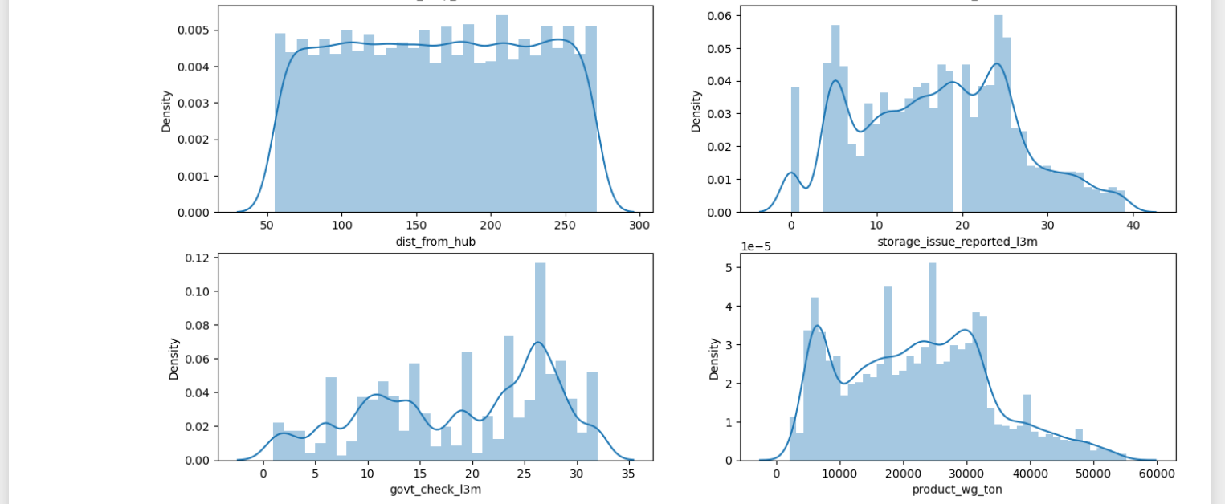
UNIVARIATE ANALYSIS

Slide 16
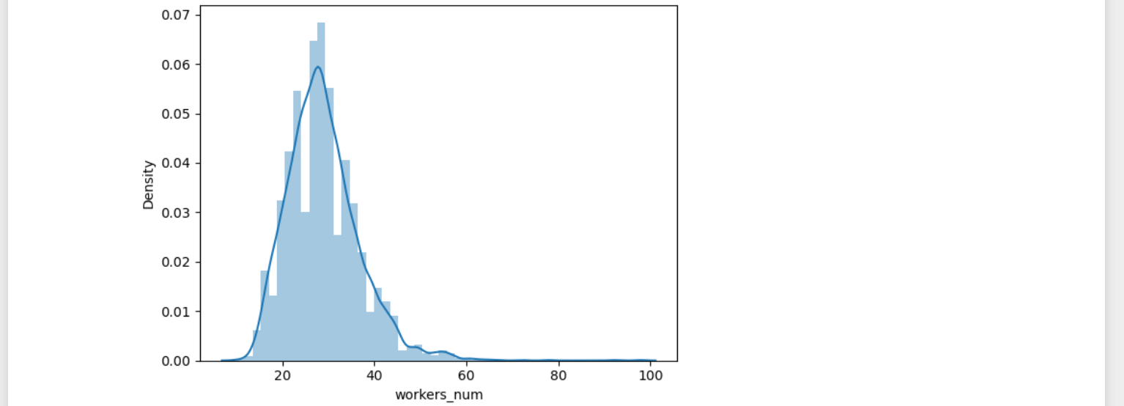
UNIVARIATE ANALYSIS

Slide 17
FINDINGS:
dist_from_hub:
Distribution of distances from the warehouse to the production hub is spread out. Peak in the middle range, indicating variation in distances among the warehouses.
workers_num:
Some what normally distributed. Peak around 24 to 28 workers, suggesting many warehouses have a similar number of workers.
product_wg_ton:
Relatively uniform distribution. Warehouses produce noodles with a variety of product weights

Slide 18
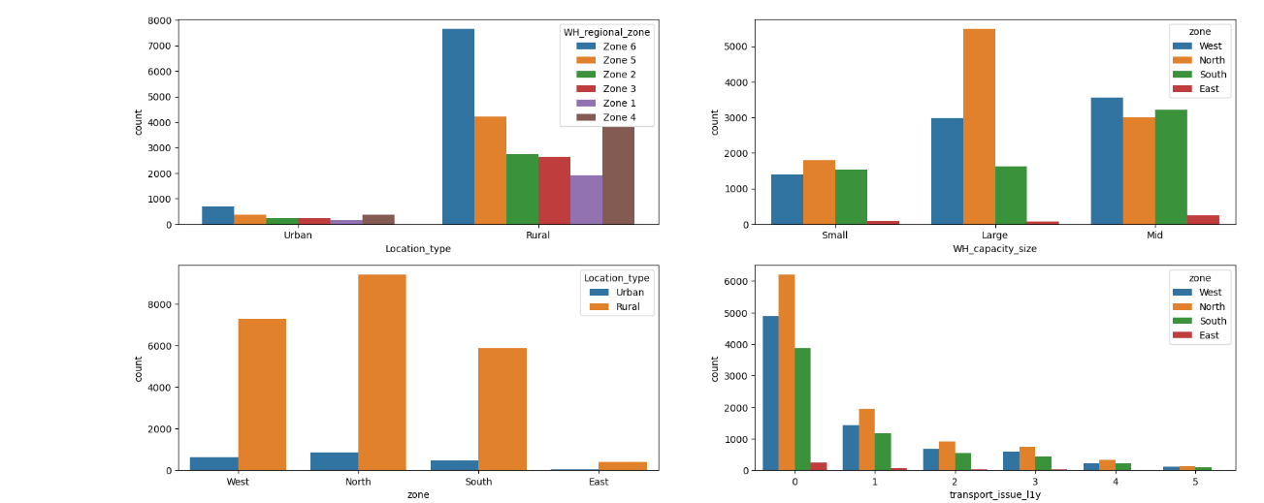

Slide 19
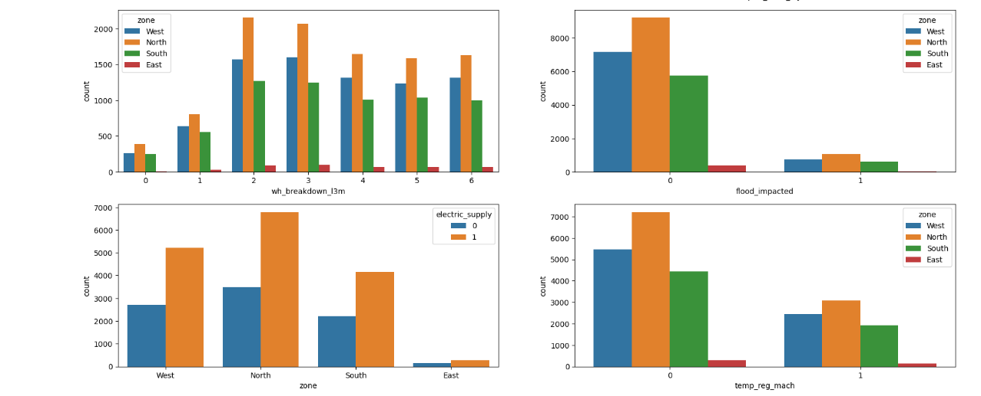

Slide 20
FINDINGS:
The majority of locations are rural, emphasizing the unique challenges in those areas.
1.In the North zone, large warehouses dominate, signifying a key capacity hub, followed by the West and South.
2.Notably, transport issues peak in rural North zones, pointing to specific logistical challenges.
3.Electric supply problems are most prevalent in the North, underscoring a critical infrastructure concern.
4.Breakdown issues are notably high in the North, followed closely by the South and West.
5.The North zone leads in shipping the heaviest products, indicative of significant logistical operations.
6.Unmistakably, the North zone reports the highest number of storage issues over the past 3 months, highlighting a critical area for improvement.

Slide 21
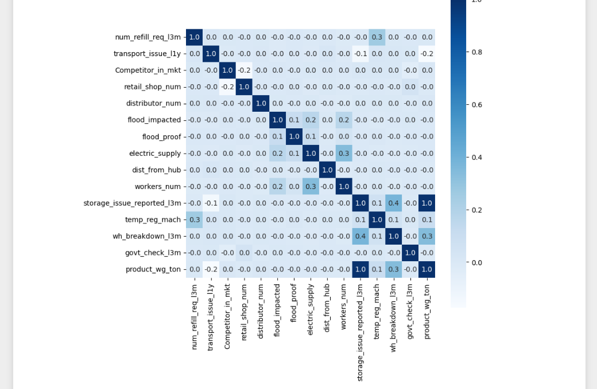
HEATMAP

Slide 22
FINDINGS:
There is a robust positive correlation (coefficient = 1.0) between the number of storage issues reported in the last 3 months and the weight of products shipped. This suggests a significant relationship, implying that as the instances of storage issues increase, the weight of products shipped from the warehouse tends to rise correspondingly.
The positive correlation coefficient of 0.4 between warehouse breakdowns in the last 13 months and storage issues reported in the last 3 months. Another positive correlation observed is that between number of workers VS electric supply and product weight vs ware house break down. all other features are not correlated

Slide 23
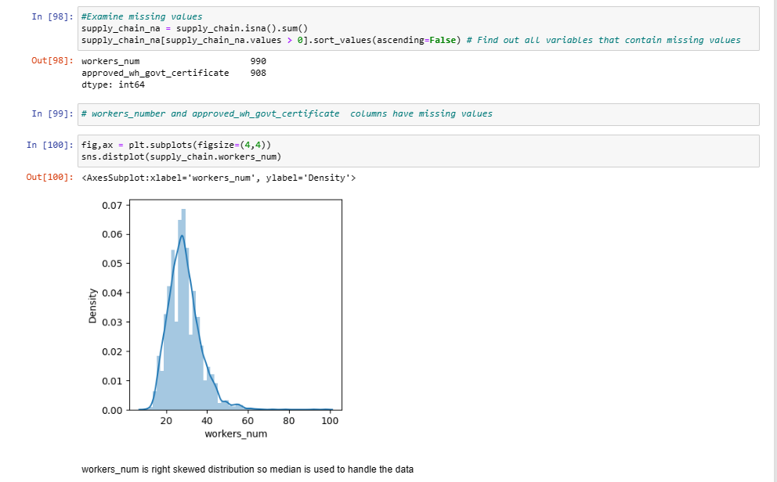
MISSING VALUE TREATMENT

Slide 24
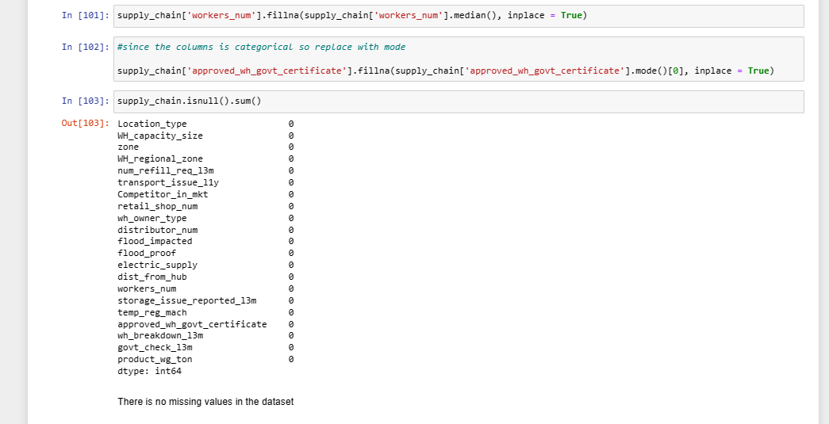
MISSING VALUE TREATMENT

Slide 25
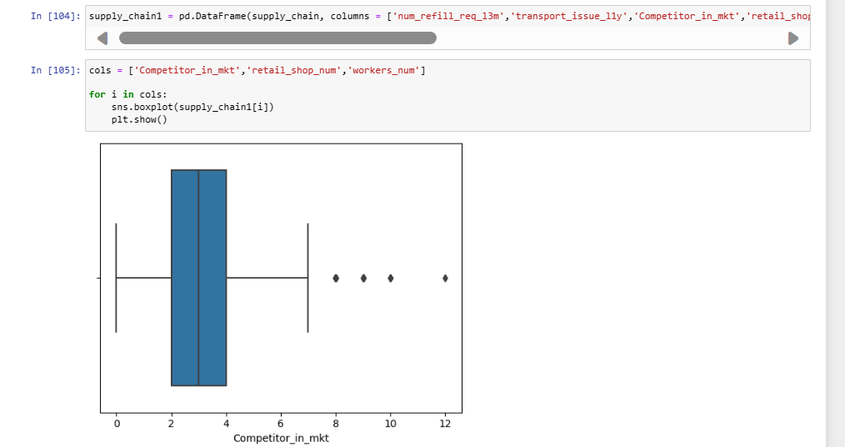
OUTLIER TREATMENT

Slide 26
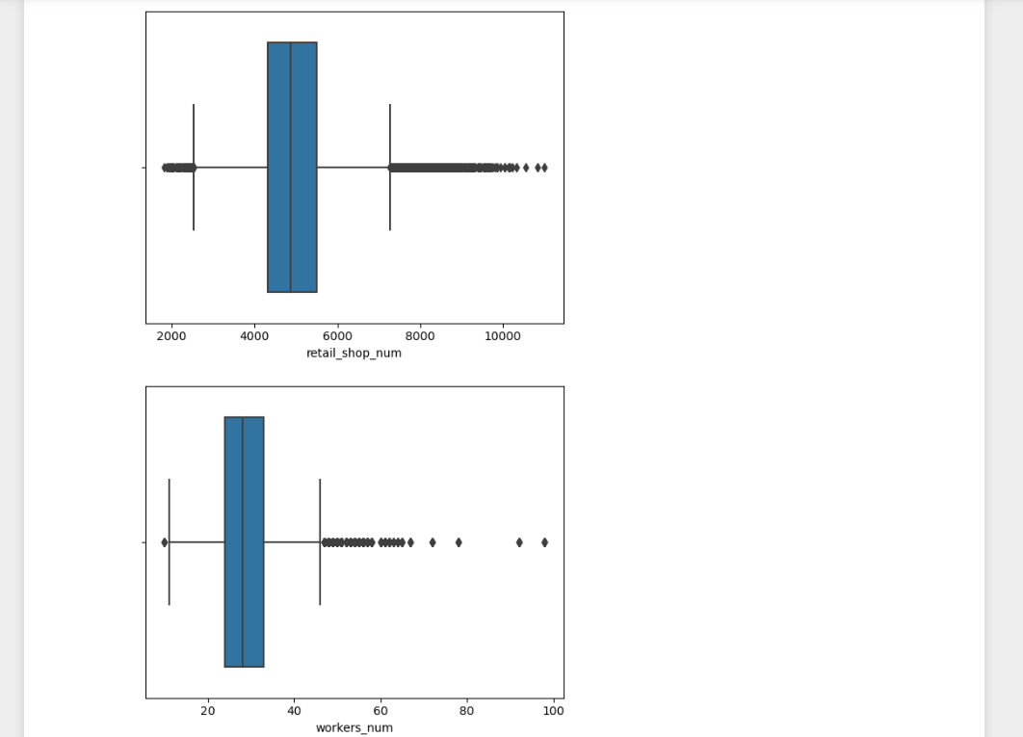
OUTLIER TREATMENT

Slide 27
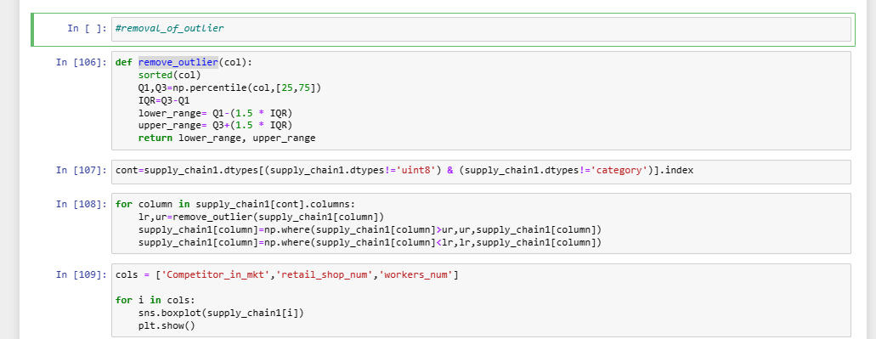
OUTLIER TREATMENT

Slide 28
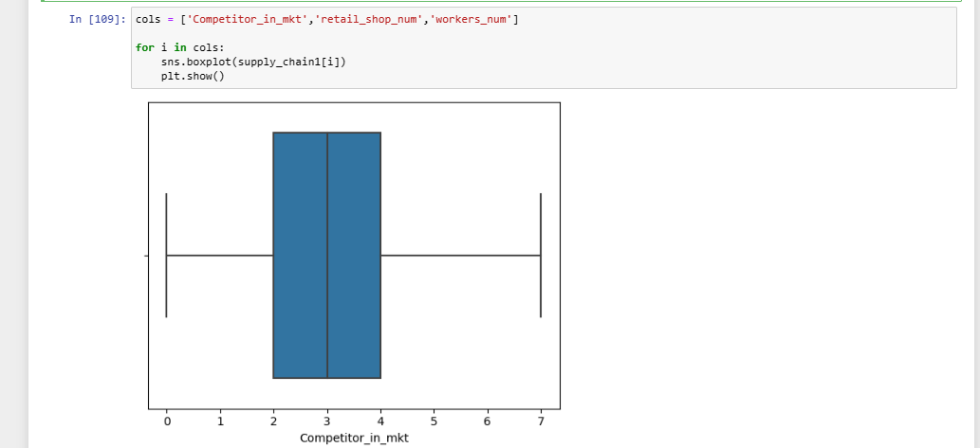
OUTLIER TREATMENT

Slide 29
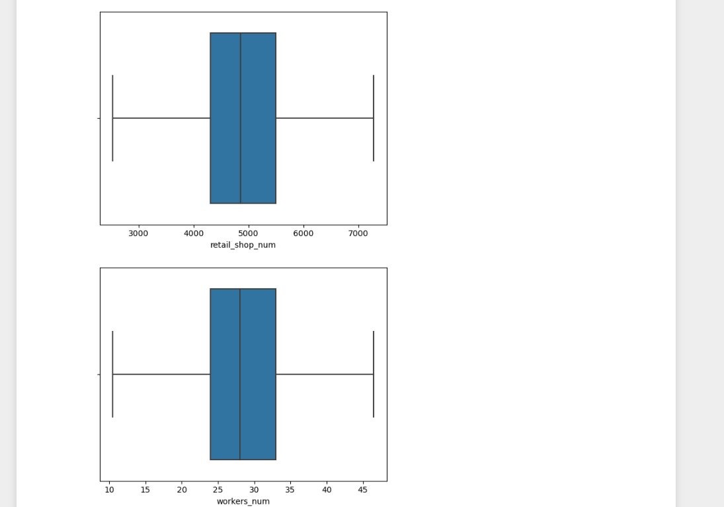
OUTLIER TREATMENT

Slide 30
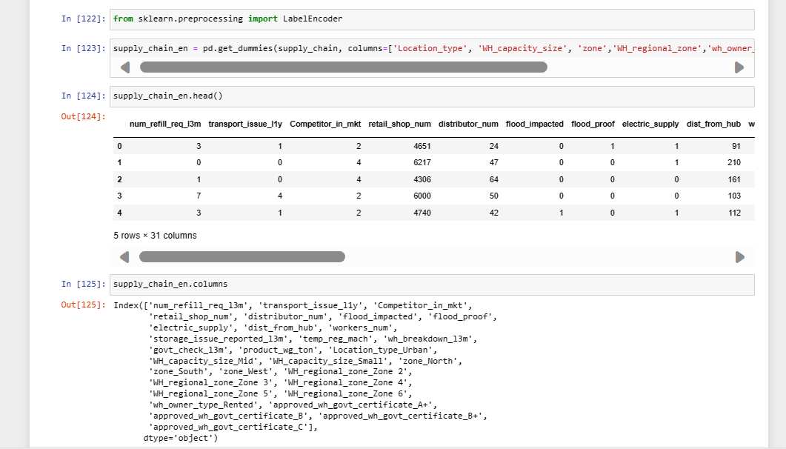
ENCODING

Slide 31
Insights from Analysis
Unwanted variables – Warehouse ID, Manager Id and Warehouse established year were removed as they don’t add value to the analysis.
Missing values – Workers_num and approved_certificate has missing values. They were imputed using median and mode respectively.
Outliers – Competitors, retail shop num and workers_num had outliers. They were treated using Inter-quartile range method.
Encoding – One-hot encoding were used for models respectively.

Slide 32
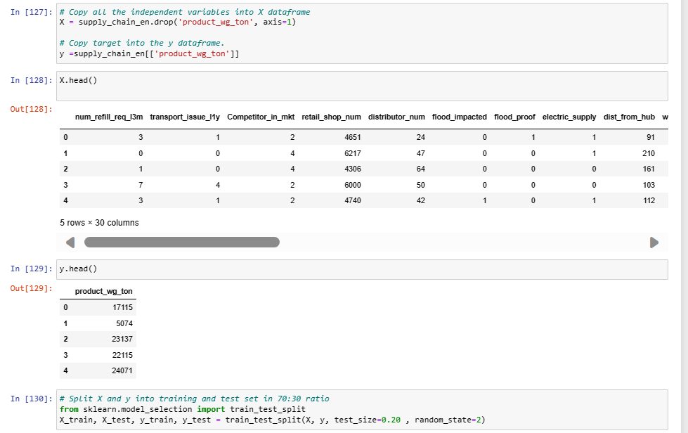
TRAIN-TEST SPLIT

Slide 33
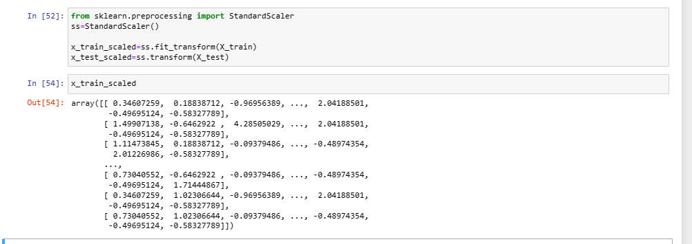
SCALING

Slide 34
Modelling Approach Used
Decision Tree Regressor
Random Forest Regressor
Linear Regression

Slide 35
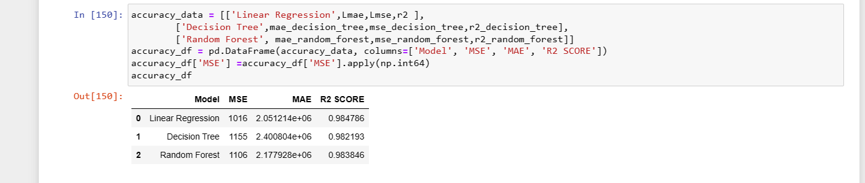
MODEL PREDICTION

Slide 36
THANK YOU

